Slide 1
ENTREPRENEURSHIP & Business Management

Slide 2
Role Models for Entrepreneurship

Slide 3

Role Models
parents, relatives, or entrepreneurs in the community.
may serve as mentors.
may help establish a moral support network.
invaluable source of counsel and advice.
Who are your entrepre-neurial role models?
Notes:
4

Slide 4
Male versus Female Entrepreneurs

Slide 5
Entrepreneurs
Men Vs. Women
motivated to achieve independence and ‘make things happen.’
Departure point: job dissatisfaction, layoff.
Support group: friends, professional acquaintances.
Initiates between ages 25-35. More likely to start a business in manufacturing, construction or high tech.
motivated to accomplish a goal and achieve independence.
Departure point: job frustration, change in personal circumstances.
Support group: spouse, family, close friends.
Initiates between ages 35-45. More likely to start a service business.
Most other dimensions show no differences.
(Hisrich & Peters, p. 76)
Notes:
5

Slide 6
Minority Entrepreneurship
Minority entrepreneurship refers to business owners who belong to a minority group. That minority status can be religious, ethnic, racial, or cultural. Sometimes, gender or sexuality plays a role as well. In some countries and communities, women entrepreneurs are considered a minority.

Slide 7
Entrepreneurs versus Inventors

Slide 8

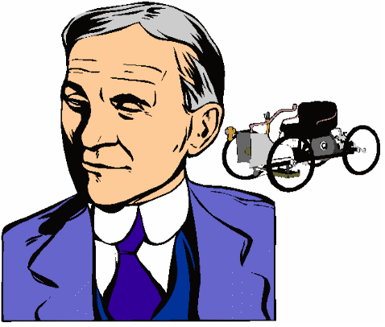
Entrepreneur Vs. Inventor
An inventor creates something for the first time. While the entrepreneur falls in love with the new venture, the inventor falls in love with the invention and often requires the expertise of an entrepreneur to launch a new venture.
Historians classify Albert Einstein as an inventive genius and Henry Ford as an entrepreneurial genius. Do you agree or disagree? Why?
Notes:
6

Slide 9
International Entrepreneurship
Process

Slide 10


International Entrepreneurship is the process of an entrepreneur conducting business activities across national boundaries.
Foreign investors helped build the early industrial base of the
United States.
Ability of US. entrepreneurs
to take advantage of foreign
markets will significantly
impact future, U.S. economic
health.
Notes:
2
2

Slide 11
Course Review
Lecture 1: a. The Nature and Development of Entrepreneurship
b. Entrepreneurship History
Lecture 2: a. The Entrepreneurial Decision Process
b. Desirability and Possibility of New Venture Formation
c. Types of Startups
Lecture 3: a. Entrepreneurship Role in Economic Development (Product Evolution, Government Role)
b. Entrepreneurship vs Intrapreneurship
c. Skills Set for Entrepreneurship
d. Entrepreneurship Ethics
Lecture 4: The Entrepreneurial Process (4 Phases)
Lecture 5: The Entrepreneurial And Intrapreneurial Mind
Corporate vs. Intrapreneurial Organizational Culture
Lecture 6: INTRAPRENEURIAL LEADERSHIP CHARACTERISTICS
ESTABLISHING INTRAPRENEURSHIP IN THE ORGANIAZATION
SUCCESS PARAMETER FOR ENTREPRENEURSHIP
Lecture 7: Role Models for Entrepneurship, Male versus Female Entrepreneurs
Minority Entrepreneurship, Entrepreneurs versus Inventors
International Entrepreneurship Process

